Slide 1
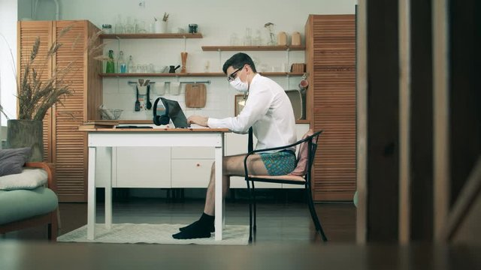
The Office
Notes:
Four years ago, almost to the day we were hit with a worldwide pandemic that sent all of us to lockdown, some of us ,for the first time, to work from home.
Remote workers are more productive because they have no commute, fewer distractions, more time for family, exercise, and overall better work-life balance.

Slide 2
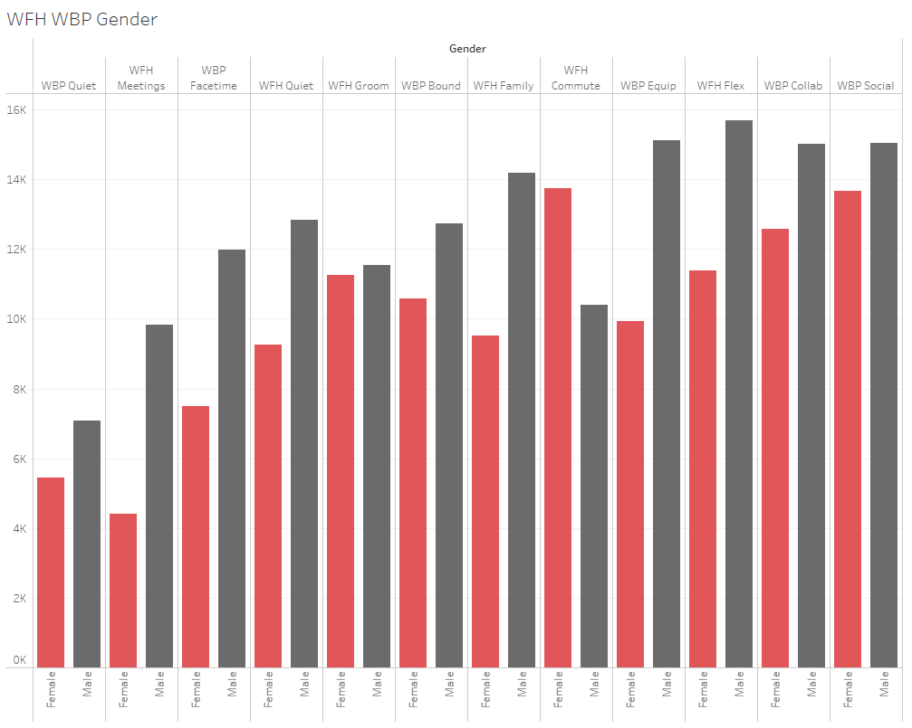
What do we want? How do we want it?
Notes:
But are there also benefits for Working from the business premesis? The office?
My dataset included a questionnaire answered by 65thousand employees who work on some scale between fully remote and fully on site, what are the benefits of each option, and what is their top 3 most important benefits.
In this graph, red represents women and black men.

Slide 3
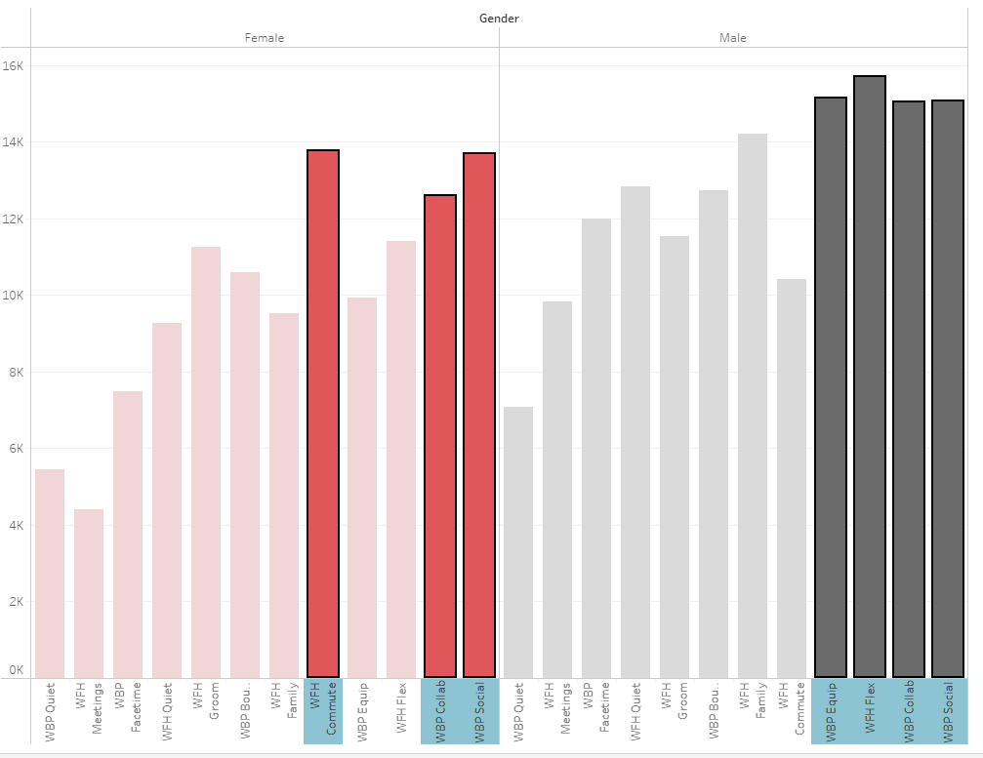
Top 3 wishlist for Women:
1) WFH - Less Commute 2) WBP - Social interaction 3) WBP - Collaboration
Top 3 wishlist for Men :
1) WFH - Flexible Hours 2) WBP - Better Equipment 3) WBP - Collaboration & Social interaction
Notes:
Top 3 wishlist for women :
WFH - Less Commute
WBP - Social interaction
WBP - Collaboration
Top 3 wishlist for Men :
WFH - Flexibility
WBP - Better Equipment
WBP - Collaboration & Social

Slide 4
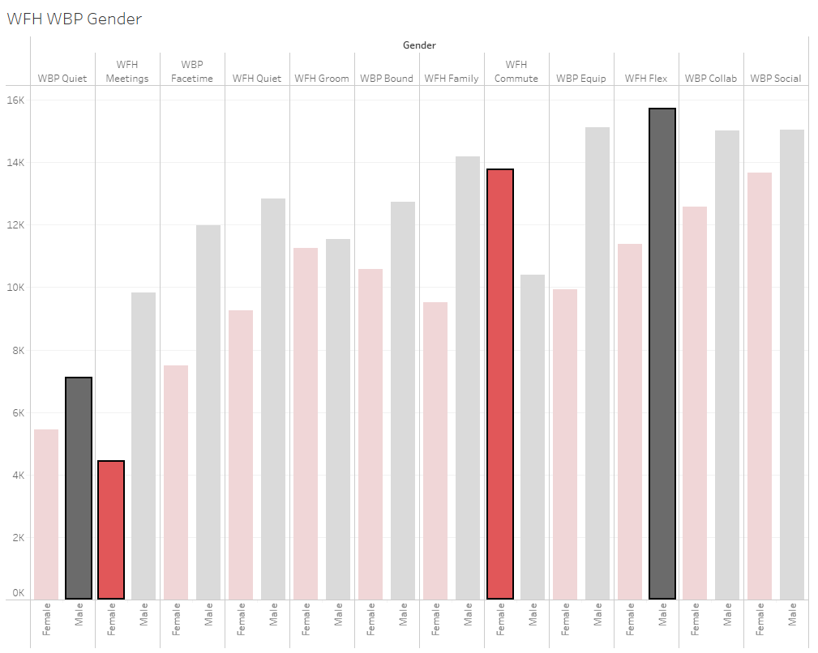
Women :
↑ WFH - Less Commute …. WFH - Meetings ↓
Men:
↑ WFH - Flexible work hours …. WBP - Quiet ↓

Slide 5
Where do YOU
want to work?
Notes:
On the basis of the participants traits, age,income, gender, and education, and their wishes, I wanted to try to predict in what kind of format they would work- Remote, hybrid or OnSite.
The most accurate model was impacted by the following traits.
Depicting our priorities and traits as employees.

Slide 6
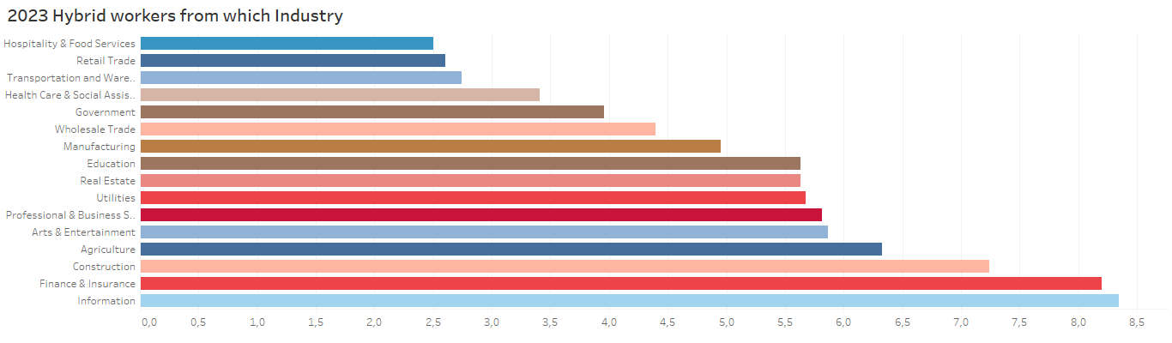
1
Industry
Notes:
The first and highest indicator for a good prediction is where do you work?? In which industry.
Note that the Information, Finance & Insurance, have the largest share of Hybrid employees

Slide 7
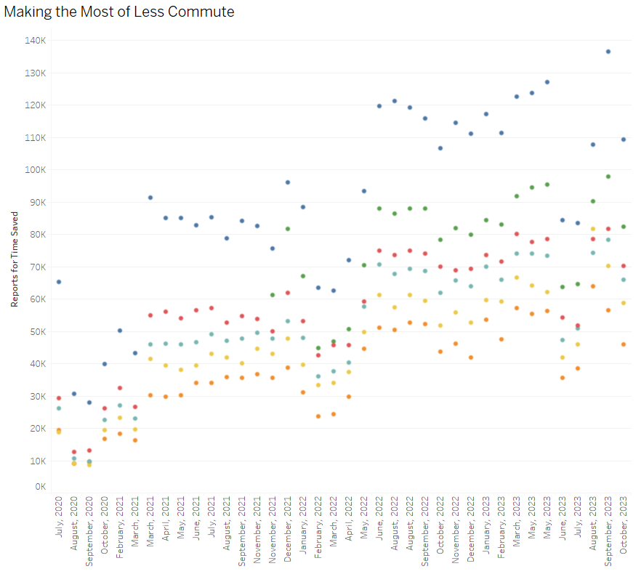
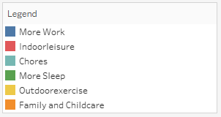
2 + 3
Commute & Family
Notes:
The second and third factors that indicate a good prediction are the wish for less commute time, and surprisingly the addition of more family time.
In this slide I wanted to show the activities done in the saved commute time of which employees reported on .
Two interesting things pop up , firstly the variety of activities, note that the highest rated is actually more work. I.e. employees reported that on the time they saved commuting, they worked more.

Slide 8
Where do THEY
want to YOU to work?
Notes:
But the big factor as to where employees across the globe will predominantly work - remote hybrid or onsite is… The employer.

Slide 9
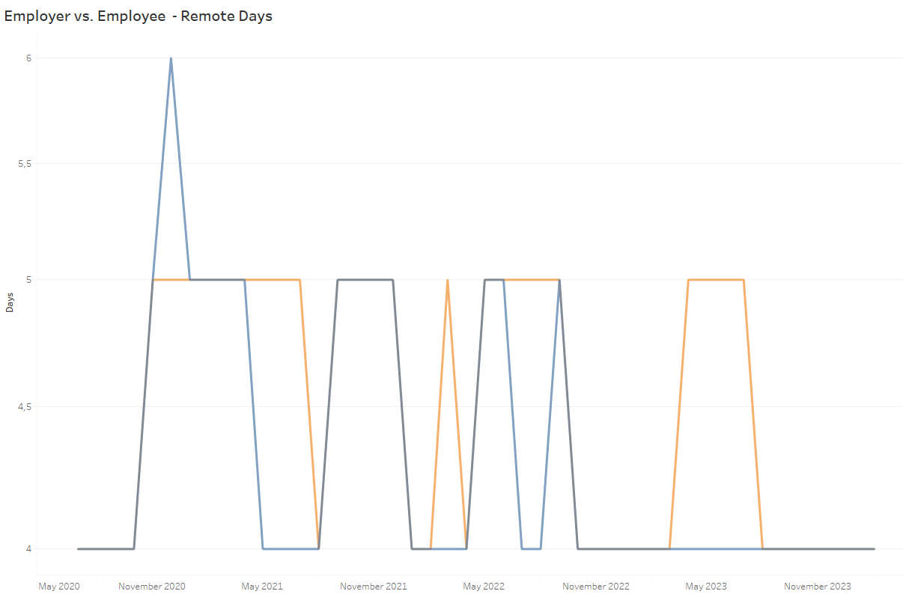

Employer vs. Employee
Notes:
Employees answering what they want - Orange, vs. what they get - Blue.
You can see the spike reacting to the pandemic, but you can also see how the employers wish flattens out to 2 days late 2022, while the employers wish fluctuates between 2-3 days.

Slide 10
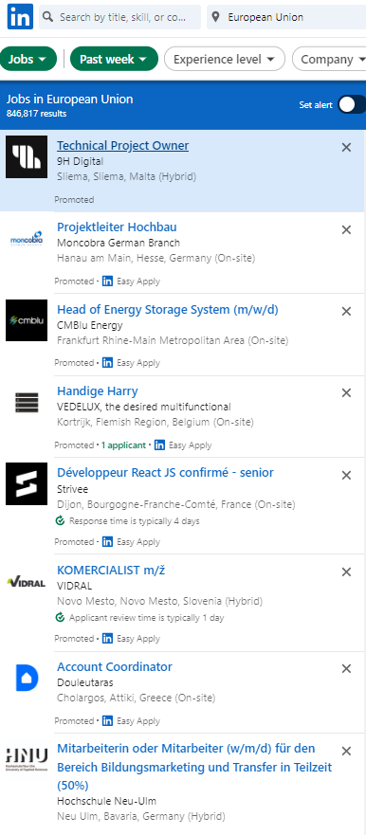
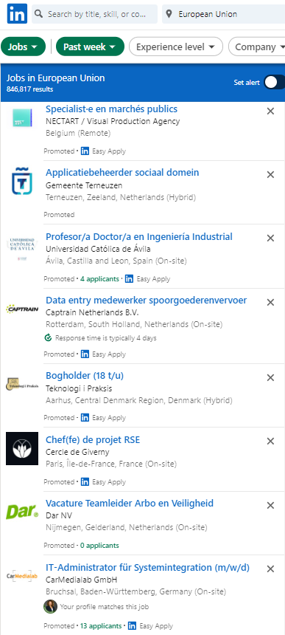
Remote / Hybrid work
is here to stay…
Notes:
Overall,from before the pandemic less than 5% of employees world wide worked completely remotely
Now around 30% of employees work some form of hybrid/remote …globally. This was confirmed in not so simple scraping of linkedin job posts.
That’s a huge shift in personal priorities, business decisions, and an overall environmental impact.

Slide 11
Thank you!

